Slide 1


Pre-Defense
Presented by
Supervised by
Name | Student ID
Md. Alifur Rahman | 220122041
Proshanto Roy Chowdhury | 220122033
Kamruzzaman | 220122021
Asadul Islam | 220122059
Md. Kauser Ahmed | 220122024
Farzana Arefin Nazira
Lecturer
Department of CSE, EUB
Pre-Defense

Slide 2
Pre-Defense
Introduction
The textile and garment industry in Bangladesh plays a pivotal role in the country’s economy.
However, the supply chain between cloth wholesalers and retailers lacks a unified, digital platform that seamlessly integrates wholesale ordering, retail management, and business growth tools.
Pre-Defense

Slide 3
Pre-Defense
Motivation
1. Fix Problems in the garment supply chain
2. Provide simple tools to manage business better
3. Help small retailers grow and succeed
4. Make it easier for wholesalers and retailers to work together
Pre-Defense

Slide 4
Pre-Defense
Related work & Literature review
No comprehensive wholesale-retail platform
No unified ecosystem
Lack of tools for retailers
Disconnected supply chain
Limited E-commerce support for retailers
Poor communication features
Pre-Defense

Slide 5

Pre-Defense
What is it?
A unified platform connecting cloth dealers, wholesales with retailers
Offers tools for POS, Garments product management.
Why is it?
To create centralized system for streamlined communication & operations
To bridge the gap between dealers & retailers with collaborative ecosystem
Pre-Defense

Slide 6
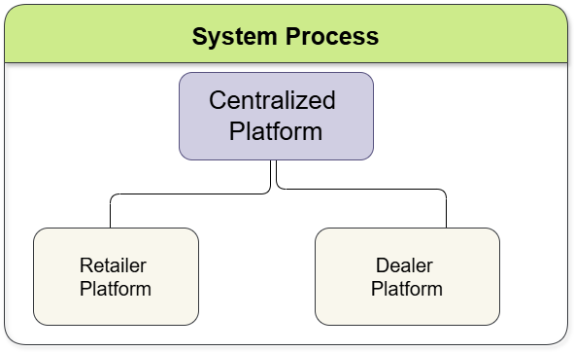
Pre-Defense
Pre-Defense

Slide 7
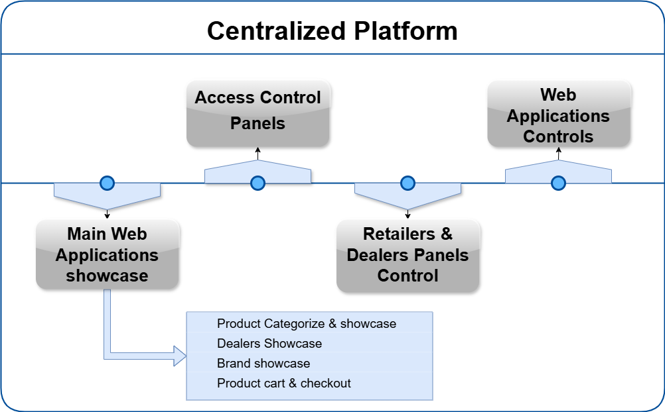
Pre-Defense
Pre-Defense

Slide 8
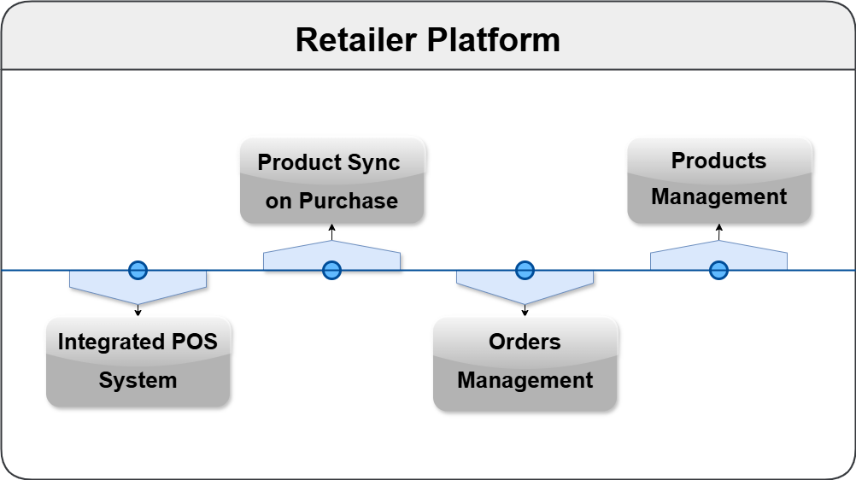
Pre-Defense
Pre-Defense

Slide 9
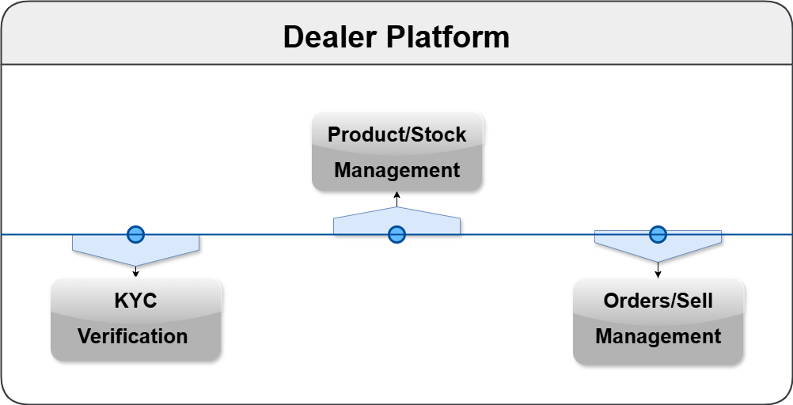
Pre-Defense
Pre-Defense

Slide 10
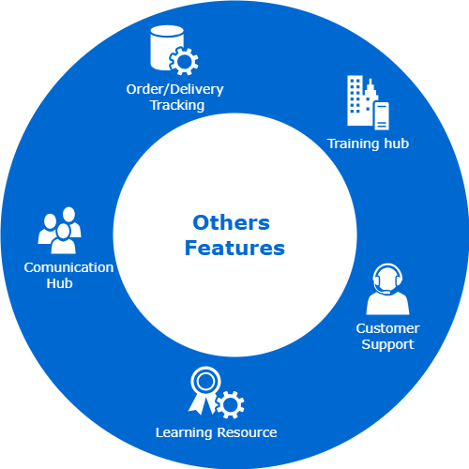
Pre-Defense
Pre-Defense

Slide 11
Pre-Defense
Future Work
E-commerce Website Builder for Retailers
Digital Payment & Credit Management
Marketing & Promotion Tools
Advanced Analytics and Forecasting Tools
Mobile App Development
Integration with Financial Services
Pre-Defense

Slide 12
Pre-Defense
Conclusion
Seamless Connectivity
Efficient Operations
Retailer Empowerment
Industry Optimization
Growth & Innovation
Stronger Partnerships
Pre-Defense

Slide 13

Pre-Defense
Pre-Defense

